Slide 1

ATEMA APARTMENT MANAGEMET
Apartments to homes

Slide 2
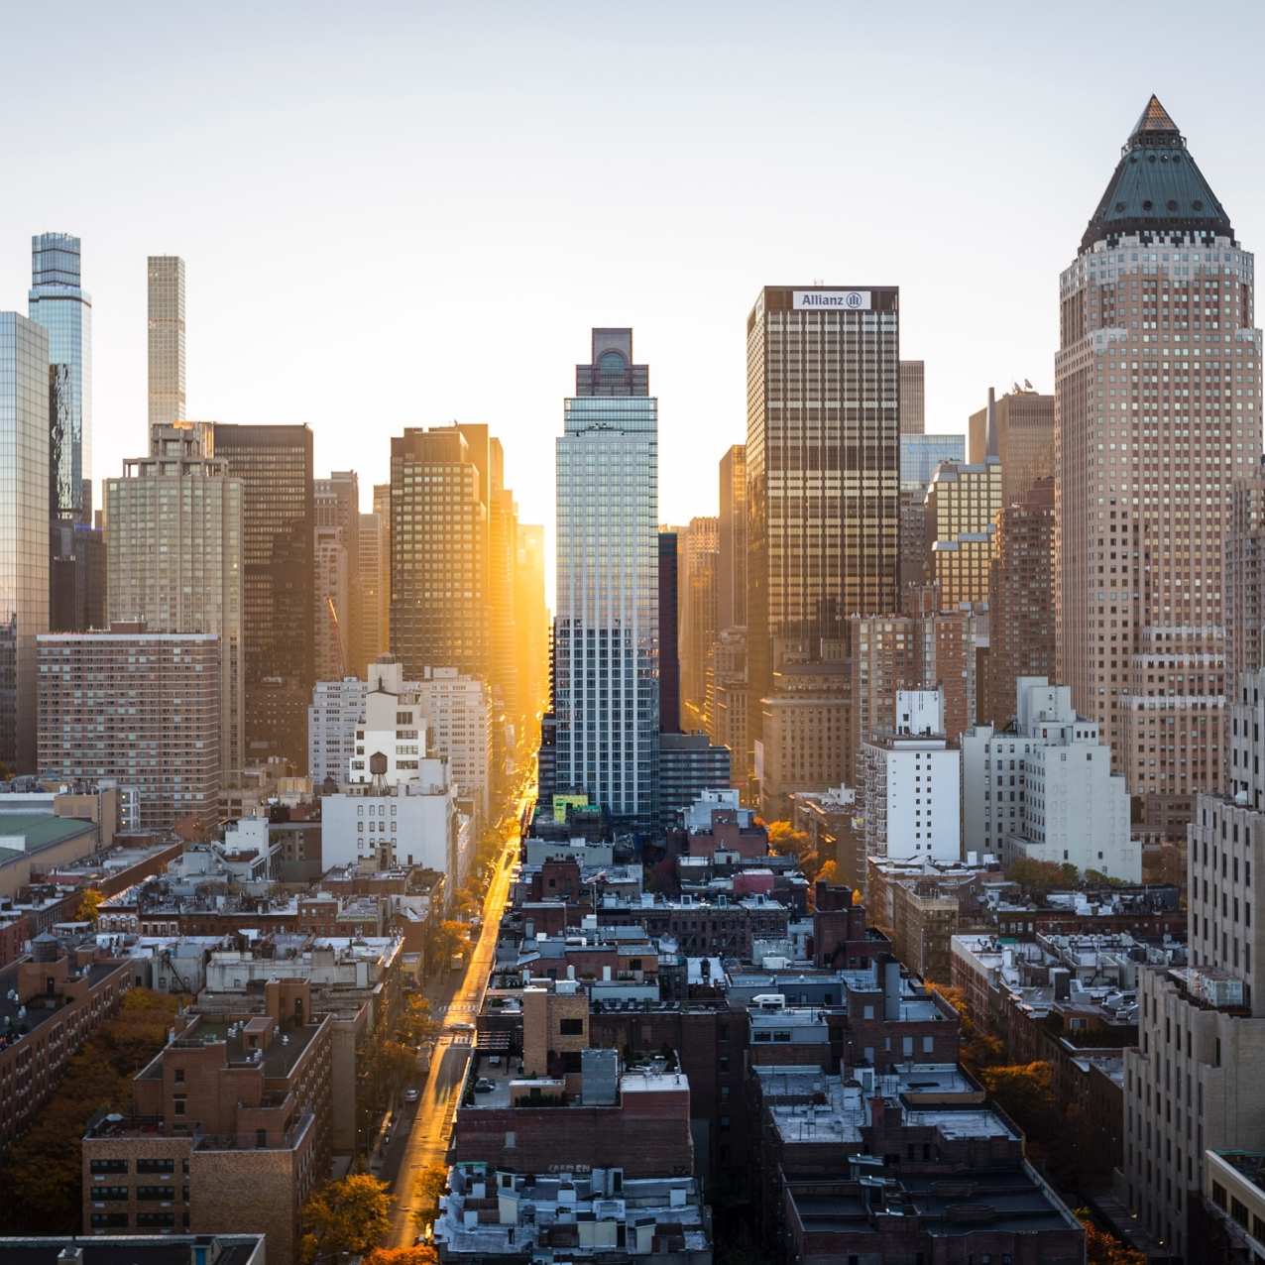
LETS CREATE COMFORTABLE SPACES

Slide 3
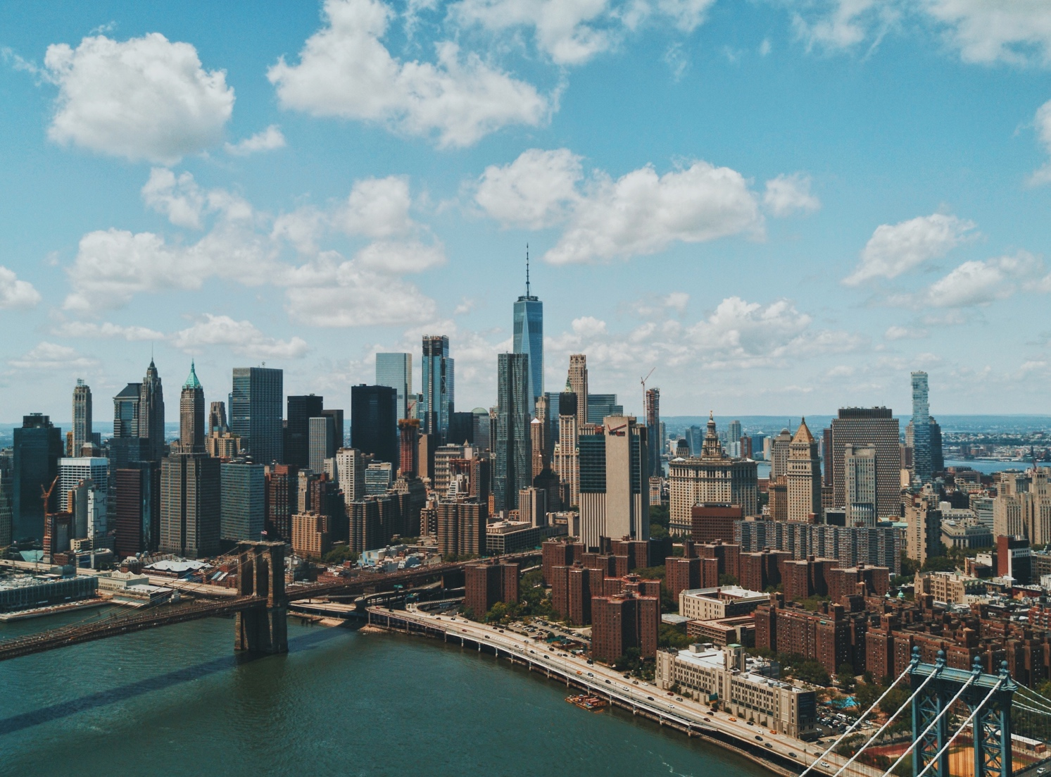
Story line
You Just moved into your new apartment in westlands, amazing right the life there has been amazing until rain season began and you start realizing the apartment you bought has some tiny imperfections that you don’t like. Now you start looking for random repair persons but they don’t know how to fix what you want

Slide 4

Hook
You finally talk to your manager and they decided to plug you to an amazing team that does the work on time, have fair rates and you loved them.
Little did you know the whole apartment is going through what you went through but didn’t know to solve it.

Slide 5

Atema apartment management system
Atema apartment management system is a web app that allows every thing to go on smoothly with easy.
ASK ME HOW???
So when 1 tenant or owner reaches out to the manager they create the need for a specific specialist.
Case study for this came from IMARA APARTMENTS.

Slide 6



PROBLEM STATEMENT
Problems with the previous system (Manual system)
CLIENTS
Data growth
Lack of reports
Data security concerns
Absence of a centralized database
As a apartment owner power work-manship
Tenant support options
Information deficiency
Availability of different technologies

Slide 7
JUSTIFICATION
JUSTIFICATION
JUSTIFICATION
The Website streamlines property searches, saving clients valuable time
Modern database technologies ensure accurate and easily accessible records
The Website facilitates improved communication and collaboration, fostering trust
4. system acts as a robust security tool, providing owners with continuous access
5. project aligns with the growing demand for modern, technology-driven solutions, ensuring relevance and competitiveness

Slide 8
RISK AND SCOPE
RISK AND MITIGATION
SCOPE
Data growth
Lack of reports
Data security concerns
Absence of a centralized database
As a apartment owner power work manship
House hunting hustles
Tenant support options
Information deficiency

Slide 9


OBJECTIVES
Implement CRUD Operations in the Database: Develop system functionalities enabling users to add, edit, search, and delete data from the database. Ensure a seamless user experience through an intuitive interface, aligning with practical needs and industry standards. Aim to have CRUD operations fully functional by the project completion date.
Facilitate Announcement Posting for Tenants and Technicians: Create a platform within the system for property agents and owners to post announcements. Enable seamless posting of announcements with specified fields and formatting options. Implement security measures to verify and authorize announcement postings, providing a valuable tool for effective communication. Enable the announcement feature within the system for user testing.
LAYOUT
Improve Apartment Process: Enhance the efficiency of the Apartment process by streamlining the workflow, leveraging technology, and addressing specific pain points in the current booking process.
Develop Comprehensive Apartment Management System: Create a user-friendly system that allows seamless access to customer data and property records. Ensure accuracy in representing all customer and information, utilizing appropriate technologies, and providing essential features catering to the needs of both Apartment owners and tenants. Complete system development within the specified timeframe.
Topic 02 comes here

Slide 10
Visual representation from research

Slide 11
Thank you
alexandergichangi@gmail.com

